Slide 1




SOVEREIGN ENGINE RESEARCH BRIEF
From Geometry Ambition to Testable Evidence
Deferred mathematics, a fail-closed feedback loop, and the first language-hierarchy experiment.
A bounded research result — not a verdict on language, mind, or reality
OFFLINE UNIVERSAL KERNEL · EVIDENCE BEFORE INTERPRETATION

Slide 2

ARCHITECTURE PREMISE
Two systems now have distinct jobs
Complementarity comes from separation: the system that proposes a geometry is not the system that proves whether its experiment met a declared standard.
QUARANTINED RESEARCH SIDE
TRUSTED EVIDENCE SIDE
Legacy runtime
↔
Universal kernel
Explores transforms, representations, feature maps, hypotheses, and candidate artifacts.
Freezes contracts, verifies artifacts, records replayable receipts, and blocks unsupported promotion.
CONTROLLED EVIDENCE CHANNEL
May: propose a new geometric candidate
Frozen inputs independent measurement bounded feedback
May: emit a result for independent evaluation
May: validate a named gate
May not: promote itself or redefine success
May: return fail or unverifiable
May not: choose a theory or train a model
Proposal is not proof. A receipt is not a theory verdict.

Slide 3

LEGACY MATHEMATICS DISPOSITION
The trusted core deliberately became smaller
The legacy geometry stack is research context and a source of future adapters—not automatic semantics for a verifier.
DEFERRED NUMERICAL GEOMETRY
DEFERRED EXPERIMENTAL GEOMETRY
REMOVED FROM VERDICT LANGUAGE
Needs a numeric contract
Needs task evidence
No automatic authority
Riemann sphere & Möbius maps
Torus update & invariant probes
E8 prompt snapping
Require exact complex schemas, pole handling, and
Training procedure and scalar proxies are experiments,
May be a feature candidate; it cannot self-certify semantic
reproducible transform rules.
not intrinsic truth measures.
or theoretical coherence.
Fubini–Study distance
C60/E8 addressing
“Globally coherent” status
Requires declared estimator, precision, tolerance, and
An encoding choice must beat matched alternatives on a
A broad runtime label is not a bounded verification
reference vectors.
declared task.
outcome.
Hopf map
Corpus quantization
Theory-selected behavior
Requires normalization and error-bound policy before a
Needs licensed data, baselines, heldout tests, and
A framework label cannot choose evaluator code or cause
receipt can mean anything.
uncertainty analysis.
a passing result.
Not declared false: the mathematics lost automatic authority until each use becomes a named, fixture-backed, independently reviewable claim.

Slide 4

NEUTRAL ADAPTER ADMISSION
Geometry returns through bounded claims
A legacy mathematical idea can re-enter the system only as a precise, inspectable question that any framework could be asked to meet.
→
→
→
→
01 · DEFINE
02 · NAME
03 · FREEZE
04 · REVIEW
05 · RECEIPT
Finite object
Relation
Fixtures
Independently
Bounded result
State exactly what is represented: values, coordinates, schema, units, and domain.
Write one predicate in ordinary language and, where useful, formal notation.
Supply positive, negative, malformed, boundary, and tamper cases before admission.
Check the evaluator, assumptions, replay path, and explicit non-claims.
Return a narrow status for declared input only: verified, fail, or unverifiable.
WHAT THE RECEIPT NEVER MEANS
A passing finite check does not validate E8, a language theory, cognition, physics, or reality. It validates only the named relation in the supplied representation.
FRAMEWORK LABELS ARE PROVENANCE—NOT EXECUTABLE AUTHORITY

Slide 5

FAIL-CLOSED RESEARCH ARCHITECTURE
The loop separates proposing from proving
Every movement from idea to admitted experimental adapter crosses a distinct evidence boundary. No arrow bypasses independent evaluation or accountable review.
01 · HUMAN
02 · QUARANTINE
03 · INDEPENDENT
04 · KERNEL
05 · REVIEW
Freeze the question
Propose a candidate
Recompute the test
Verify the evidence
Decide the scope
→
→
→
→
Human authority accepts, rejects, or quarantines the experiment with an explicit rationale.
Lock the hypothesis, dataset, split, baseline, metric, budget, and falsification rule.
The legacy runtime emits a transform or artifact—never its own passing verdict.
A separate evaluator runs pinned inputs, baselines, and resource limits.
Check manifests, hashes, allowed predicates, holdout rules, and reason codes.
NO AUTONOMOUS PROMOTION
↖
BOUNDED FEEDBACK PACKET
The runtime receives only allowed metrics, failure reasons, and next
permitted actions—never release keys, mutable evidence, or authority to
rewrite the gate.
Evidence does not stop exploration. It turns each new proposal into a claim that can win, fail, or remain unresolved.

Slide 6

FEEDBACK-LOOP CONTROLS
No component gets to certify itself
The loop is useful only when candidate generation, measurement, evidence verification, and human judgment remain deliberately separate.
NO SELF CERTIFICATION
01
Frozen proposal digest
04
Holdout and replication
The task, data split, metric, baseline, budget, and non-claims are fixed before results appear.
Development-set success is exploratory; durable claims require held-out evidence and reruns.
02
Independent evaluator
05
Append-only evidence
Candidate-reported scores stay provisional until a separate runner recomputes them.
↕
Inputs, outputs, manifests, and receipts cannot be silently replaced after the fact.
03
Baseline and ablation suite
06
Human release authority
A geometry candidate must beat simpler, matched alternatives—not a straw comparison.
People remain accountable for interpretation, risk, sharing, and any promotion decision.
The loop learns from failure. It never rewards self-confirmation.

Slide 7

BOUNDED HIERARCHY-RECOVERY EXPERIMENT
First pilot: a public lexical hierarchy
The experiment asks a narrow question: can a declared geometric candidate recover held-out parent links better than a simple text-only baseline?
PUBLIC SOURCE
PREDICTION TASK
Open English WordNet 2025
Recover the direct parent of a held-out node
Synset lemmas and definitions create the representation. Hypernym links are used only as evaluation labels, never as a feature supplied to either method.
A public lexical network of English words, synsets, and relations. The pilot samples a finite hierarchy rooted at animal.
DECLARED BASELINE
DECLARED CANDIDATE
Euclidean cosine similarity
Poincaré-ball ranking heuristic
TF-IDF from lemmas plus definitions, reduced by SVD and compared directly in a text-only representation space.
The same text representation receives a text-derived radial coordinate and is ranked by declared Poincaré distance.
License: CC-BY 4.0
Lexicon: oewn:2025
TEXT → TF-IDF → SVD → COSINE RANKING
TEXT → TF-IDF → SVD → POINCARÉ RANKING
Ground truth: direct hypernym links
Data policy: pinned source + manifest
Controls: deterministic selection/holdout split; candidate settings selected only on the selection edges; held-out recovery measured independently; random Top-1 reference retained for context.
SCOPE: A FINITE ENGLISH LEXICAL SAMPLE, NOT A COMPLETE MODEL OF LANGUAGE OR MEANING

Slide 8

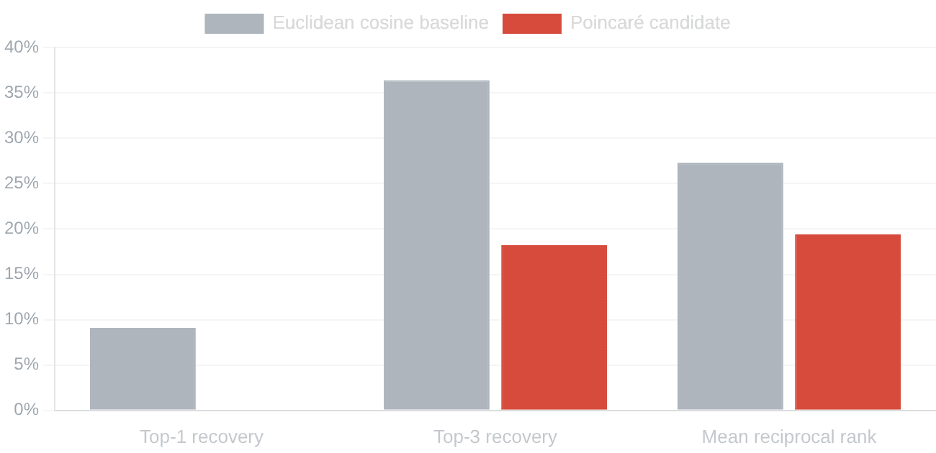
OBSERVED PILOT RESULT · HELD-OUT DIRECT-HYPERNYM RECOVERY
The hyperbolic candidate did not win
Open English WordNet sample · 11 held-out edges · text-only representations · fixed result, not a theory verdict.
HIGHER IS BETTER
GATE READING
No supported hierarchy advantage on this sample
Top-1 parent recovery
9.1% baseline 0.0% candidate
Top-3 parent recovery
36.4% baseline 18.2% candidate
Mean rank
10.727 10.727
Bootstrap 95% interval for candidate minus baseline Top-1: −27.3 to 0.0 percentage points.
Source: `artifacts/hierarchy_recovery_v0/EXPERIMENT_REPORT.md`
Scope: one public English lexical sample; no E8, Hopf, cognition, or universal-language claim tested

Slide 9

INTERPRETATION DISCIPLINE
Negative results are evidence
The pilot did not establish the hoped-for advantage. That makes the next claim smaller and the next experiment more useful.
WHAT THIS PILOT DOES NOT SUPPORT
WHAT REMAINS OPEN
This text-derived Poincaré heuristic did not outperform the simple Euclidean cosine baseline on this held-out sample.
Other hyperbolic methods
A learned geometry, different objective, or stronger benchmark may behave
differently.
Other language structures
Hierarchy recovery is one lexical task, not all semantics, syntax, discourse, or
The result is not a silent failure. It is a replayable constraint on one candidate, one task, one corpus slice, and one evaluation rule.
multilingual language.
Other legacy transforms
A future E8-related or Möbius-related candidate may be tested if it meets the
same neutral admission gate.
NEVER TESTED HERE
E8, Hopf fibrations, cognition, consciousness, physics, or a universal geometry of language. None can be inferred from the pilot’s negative or positive metrics.
Evidence narrows the story. That is how a research system becomes more informative after a loss.

Slide 10

RESEARCH PROGRAM
The next question is precise
A geometry claim earns attention only when it predicts something useful beyond simpler explanations—and can visibly lose when the evidence does not support it.
ID
HYPOTHESIS
WHAT WOULD COUNT AS AN HONEST TEST
H1
Hyperbolic hierarchy benefit
Beat matched Euclidean baselines on preregistered held-out tasks
A hyperbolic representation improves stated hierarchy recovery.
Control for parameter count, training budget, data split, and model capacity; publish null results and failures.
H2
Intrinsic-dimension signal
Survive controls for length, genre, layer, corpus, and estimator
Local dimension distinguishes declared language conditions.
Require estimator sensitivity analysis, shuffled-text controls, and independent corpus replication.
H3
Topology predicts capability
Outperform standard representation metrics on held-out prediction
A predeclared topology statistic forecasts held-out linguistic behavior.
Correct for multiple tests and test whether simpler variables explain the apparent effect.
H4
Legacy geometry adds value
Beat matched non-E8 transforms under equal budgets
A specified legacy transform improves a task beyond equally expressive controls.
Pin the transform, compare ablations, rerun independently, and state where the benefit does not generalize.
EVIDENCE RULE
A result may win, fail, or remain unresolved. Every outcome is informative; none alone identifies the true geometry of language, mind, or reality.
RESEARCH CLAIM = SPECIFIED REPRESENTATION + SPECIFIED DATA + SPECIFIED TASK + SPECIFIED COMPARISON

Slide 11

CLOSING PRINCIPLE
PRIORITIZED IMPLEMENTATION PATH
Controlled exploration is the path forward
01
Freeze experiment schemas
Pin hypotheses, datasets, splits, metrics, budgets, non-claims, manifests, and tamper fixtures.
02
Run candidates in quarantine
The first pilot did not support its hyperbolic candidate. That is not a dead end: it is the first evidence record in a system designed to learn without pretending.
Use bounded evaluators with read-only inputs, no release-key access, and independently recomputed results.
03
Compare matched controls
Require Euclidean, random, and equally expressive non-E8 alternatives before a geometry claim advances.
“Preserve ambition. Demand evidence. Keep the meaning of every result honest.”
04
Publish negative cases
Keep failures, limits, and uncertainty visible so the research portfolio accumulates knowledge instead of folklore.
05
Admit only scoped experiments
Independent replication and accountable review can admit an experimental adapter—never a final theory verdict.
What the project can now say: a declared question was tested, this is the evidence, this is the limit, and this is the next responsible question.
SOVEREIGN ENGINE · EVIDENCE BEFORE INTERPRETATION

